Slide 1
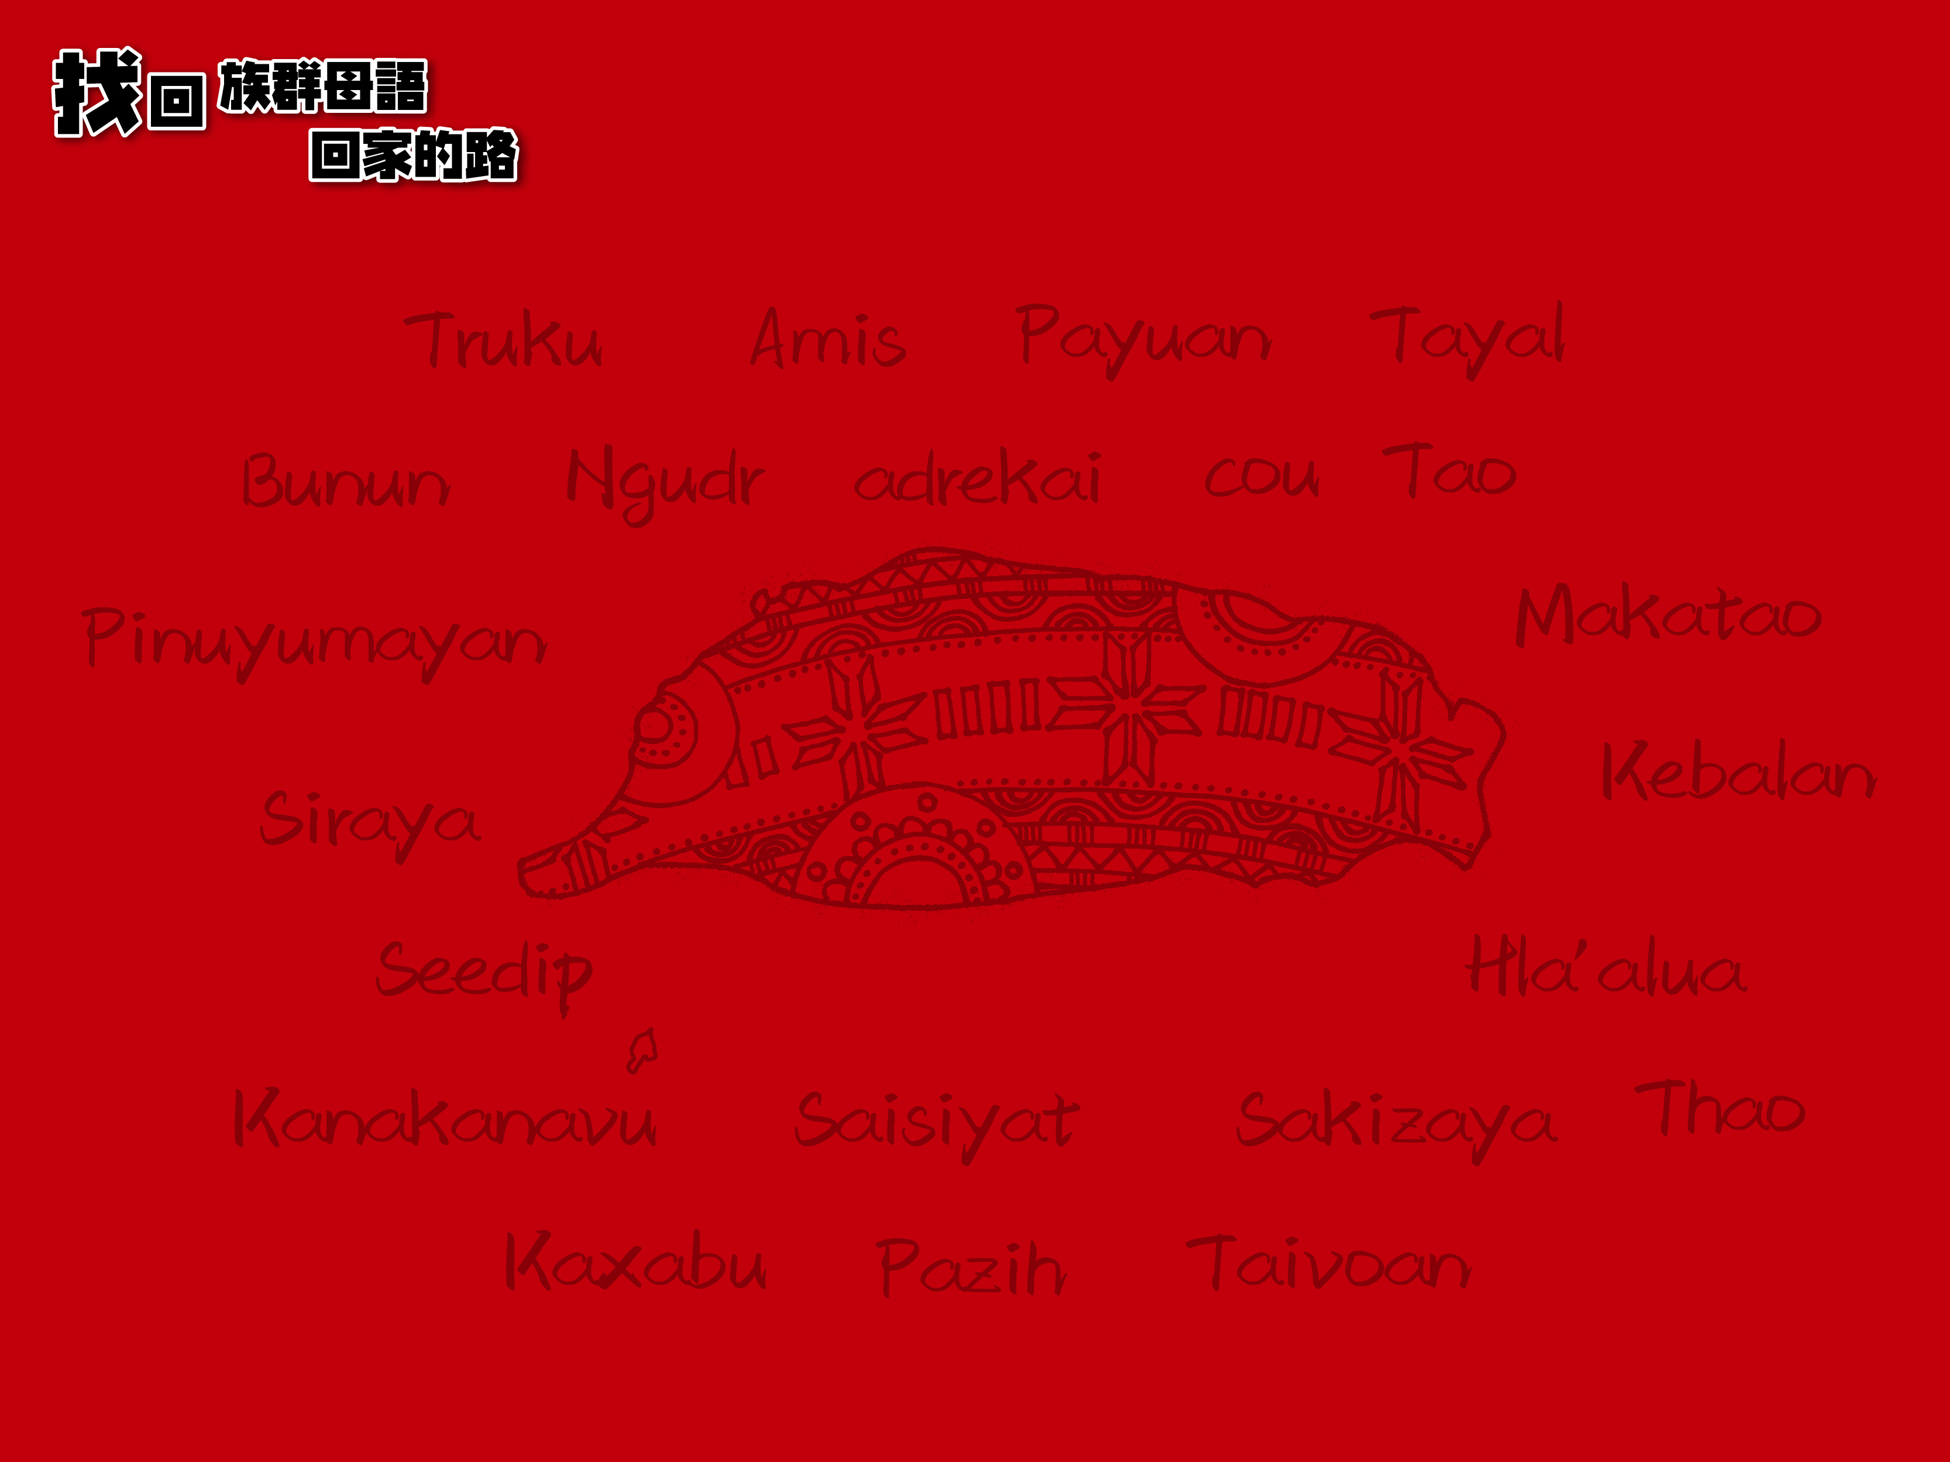
Kipasilapa
ku sangwamutavanane ka kadalranane
ki kacalrilrisyanane ka vaga

Slide 2
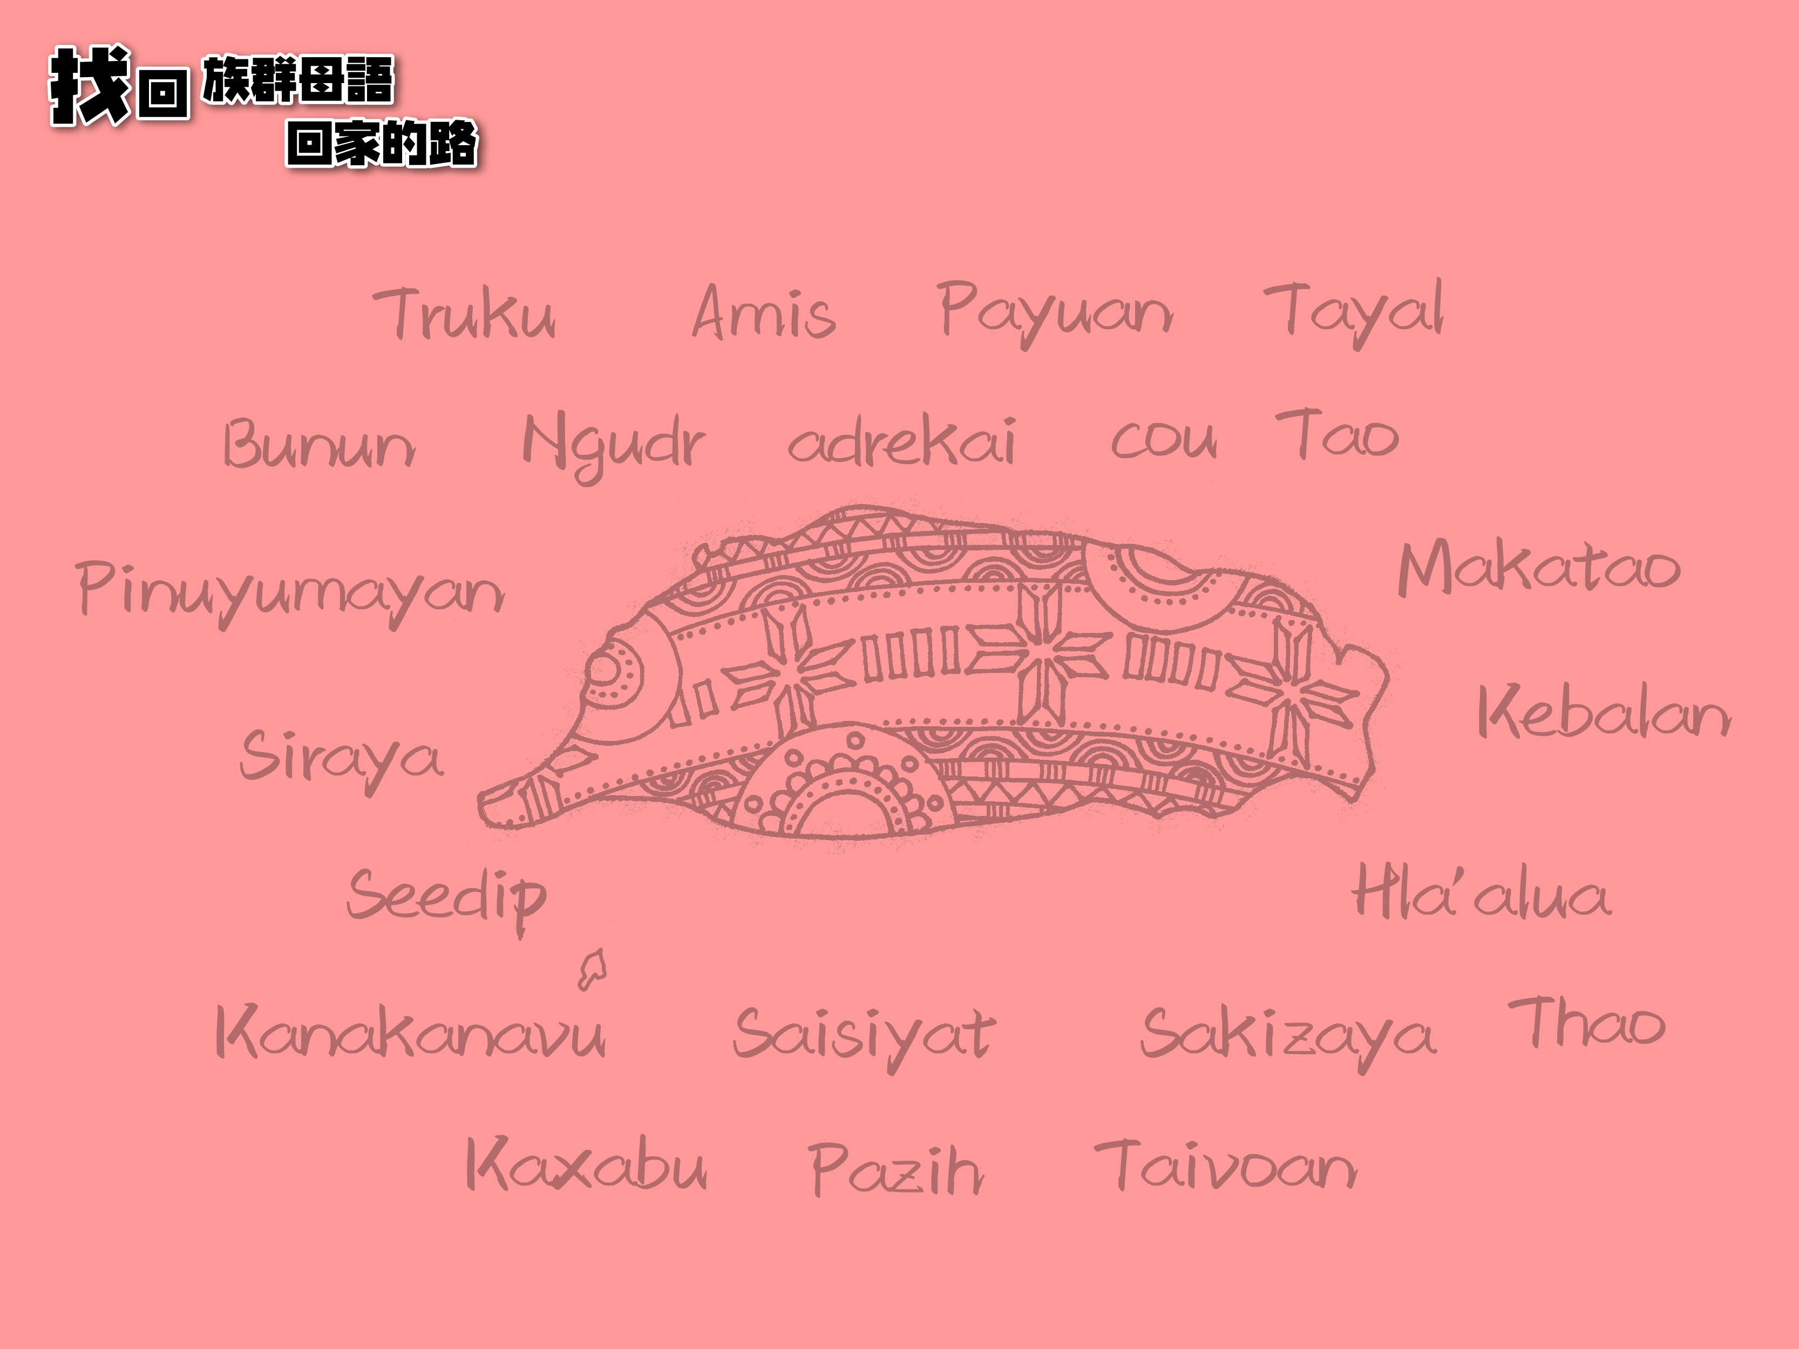
Kipasilapa
ku sangwamutavanane ka kadalranane
ki kacalrilrisyanane ka vaga

Slide 3
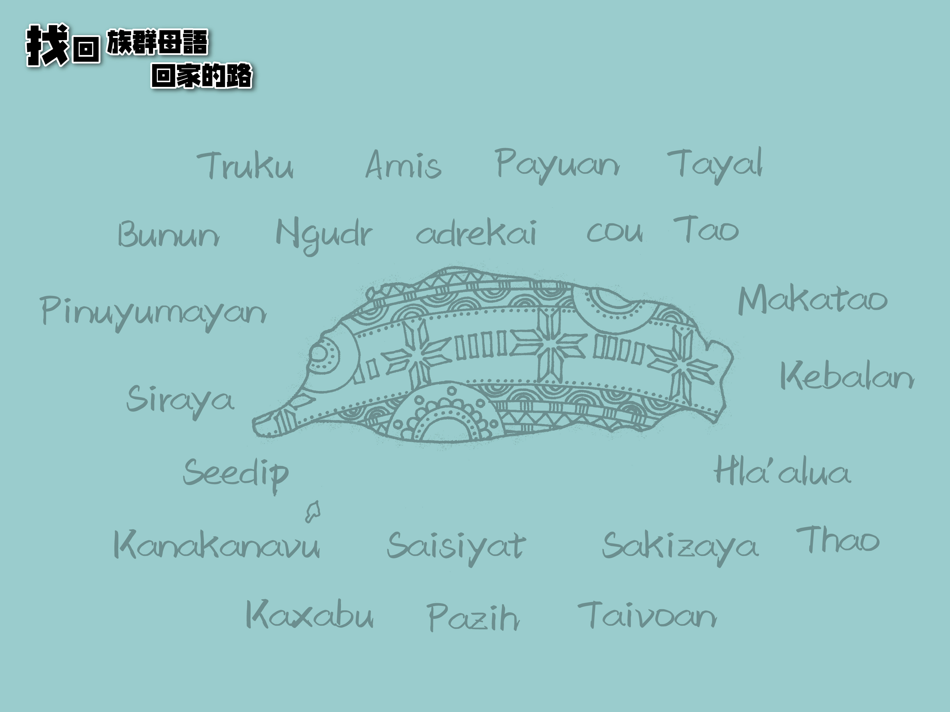
Kipasilapa
ku sangwamutavanane ka kadalranane
ki kacalrilrisyanane ka vaga

Slide 4
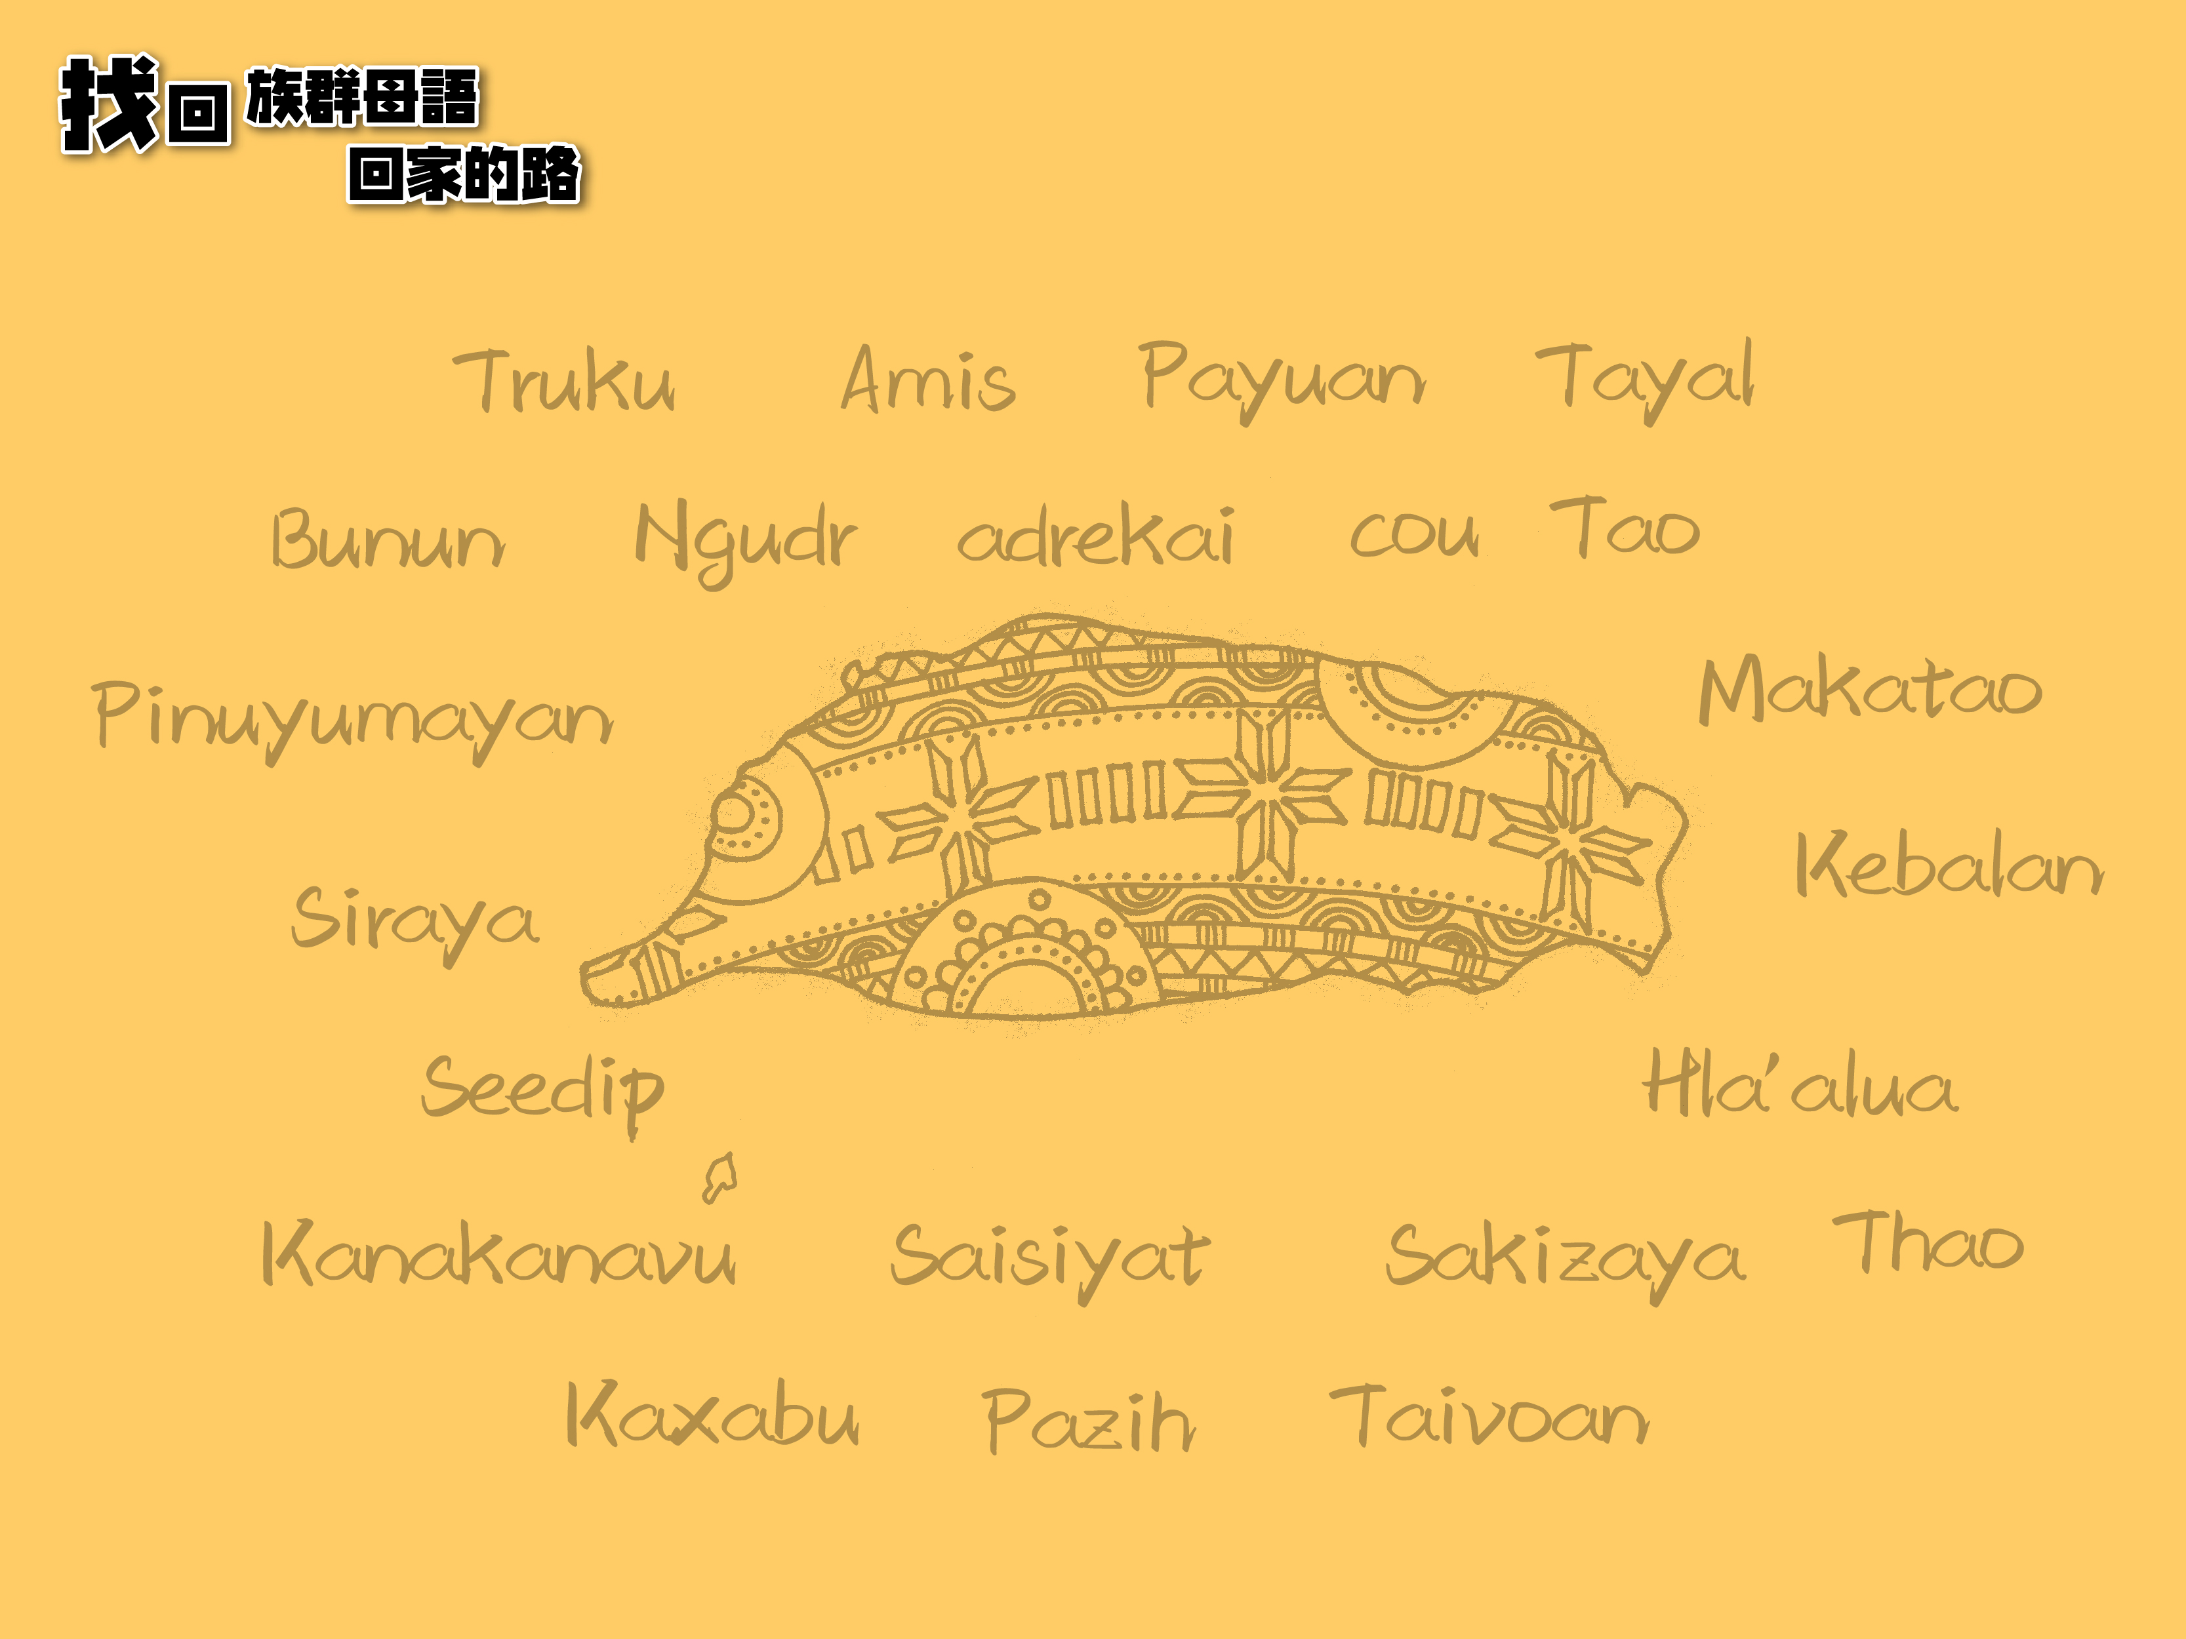
Kipasilapa
ku sangwamutavanane ka kadalranane
ki kacalrilrisyanane ka vaga

